Slide 1

User Roles, APIs, and More

Slide 2
User Roles

Slide 3
Whistleblower
Title: Secure and Anonymous Reporting of Corruption
As a whistleblower,
I want to report instances of corruption securely and anonymously,
So that I can expose corrupt practices without fear of retribution or harm.

Slide 4
User requirements:
Secure Submission Form
Different type of submissions (different file types)
Different ways of submitting (SMS, WhatsApp, Website, etc...)
Anonymity Assurance
Confirmation of Receipt
Feedback Mechanism (e.g., through a unique report ID).
Guidance on Reporting
Information on Legal Protection

Slide 5
NGOs:
Title: Leveraging Data for Anti-Corruption Campaigns
As an NGO, we are dedicated to promoting transparency and fighting corruption.
We want to use the platform to gather evidence and mobilize support for our cause.
So that we can effectively campaign against corrupt practices and advocate for policy changes.

Slide 6
User Requirements:
Discovering the Platform (User-friendly interface)
Data Gathering: The platform's advanced search capabilities and access to a wide range of data sources make it easier for us to find relevant information.
Evidence Analysis: Our analysis is supported by the platform's tools that allow us to cross-reference data and track changes over time.
The platform's networking features help us to connect with other activists, NGOs, and concerned citizens.
Monitoring Impact: We continue to use the platform to monitor the situation. We track whether the government implements the promised changes and continue to hold them accountable.

Slide 7
Citizen journalist/independent media outlet
Title: Empowering Citizen Journalism for Unbiased Reporting
As a citizen journalist/independent media outlet, we aim to provide unbiased and accurate news coverage in Lebanon, where mainstream media often face political pressures.
We want to use the platform to uncover and report on stories that are neglected or altered by traditional media due to these pressures.
So that we can inform the public with truthful information and promote transparency and accountability in the media landscape.

Slide 8
Requirements:
The user seeks a platform committed to transparency and providing access to a diverse range of data sources.
The platform should grant access to local data, official government documents, and community insights for in-depth research.
The user requires tools to analyze data trends, connect information, and build compelling narratives for story development.
Independent publishing channels and wider content dissemination options are essential for reaching a broader audience.
The platform should serve as a networking hub, facilitating connections with fellow journalists and media outlets to foster collaboration.

Slide 9
Law Enforcement
Title: Enhancing Investigations through Data-Driven Insights
As a law enforcement/regulatory agency, we are committed to upholding the law and ensuring accountability, especially in matters of corruption and malpractice.
We want to use the platform to access comprehensive data that can aid in initiating and conducting effective investigations.
So that we can enforce anti-corruption laws more efficiently and ensure justice and accountability in our jurisdiction.

Slide 10
User Requirements:
Integration of the platform provides access to extensive data, including financial records, government contracts, and citizen reports.
Regular data monitoring identifies potential corrupt practices or legal violations before escalation.
The platform's data serves as a valuable starting point for launching investigations.
Collaboration through the platform enhances efforts to tackle complex cases involving multiple entities.
Comprehensive data supports the development of strong cases, increasing the likelihood of successful prosecution.
The platform aids in tracking case outcomes, fostering transparency, and deterring future corrupt practices.

Slide 11
Data Scientists/ Machine Learning Experts:
Title: Unleashing the Power of Data Science for Societal Insights
As a data scientist/machine learning expert, I am constantly looking for rich, reliable datasets to apply advanced analytics and uncover meaningful insights.
I want to use the platform's comprehensive dataset, especially in a context like Lebanon where other data sources can be limited or compromised.
So that I can apply machine learning and data analysis techniques to derive insights that can inform policy, aid in societal development, and contribute to academic research.

Slide 12
User Requirements:
I discover the platform known for reliable Lebanese socio-economic and political datasets.
I explore diverse data, from government spending to public opinion, providing a rich ground for analysis.
Based on available data, I brainstorm project ideas, from predictive models to sentiment analysis.
I clean and structure data using platform tools, applying machine learning for pattern discovery.
I validate and refine models for improved accuracy based on results.
Models yield insights informing policymakers, academics, and public opinion.
I share findings with government bodies, NGOs, and academics, fostering data-driven approaches.

Slide 13
General User​
Title: Citizens Empowering Transparency and Accountability
As a member of the general public, I am concerned about corruption in my community and am interested in supporting initiatives that promote transparency.
I want to use the platform to stay informed about local corruption issues and to report any instances of corruption I encounter.
So that I can contribute to building a more transparent and accountable society and benefit from the positive changes this brings.

Slide 14
User Requirements:
I discover the platform, attracted by its focus on exposing corruption.
I use the platform to stay updated on corruption cases and transparency efforts.
I report corruption securely and anonymously through the user-friendly system.
I engage in community discussions and connect with concerned citizens.
Motivated by platform insights, I actively support local anti-corruption initiatives.

Slide 15
Requirements For Platform
Whistleblowing open source code (platform that has code on github that we can customize)
Data Visualization and Representation: https://github.com/javierluraschi/awesome-dataviz
Geo mapping

Slide 16
Option 1
Integrate platforms (using open-source code) for both Whistleblowing and data mapping and represention:
Whistle Blowing Backend: Global Leaks (in Python)
Geo mapping (in Frontend): Leaflet Library
Data Visualization: D3.js, Chart.js, or any other library.

Slide 17
GlobalLeaks: WhistleBlowing Platform
Entirely manageable from a web administration interface
Support for assigning and creating case management statuses
Let whistleblowers decide if and when to confidentially declare their identity
Customizable Questionnaires: Whistleblowers respond to tailored questionnaires designed by the administrators of the GlobalLeaks instance, ensuring relevant information is collected securely.
Exchange multimedia files with whistleblower
Chat with whistleblower to discuss the report
Whistleblowing system statistics
Simple recipient interface for receiving and analyzing reports
Support for the categorization of the reports with labels
Support for the user search of report

Slide 18
User Role Accounts in Global Leaks:
Whistleblower Account
Can submit information anonymously, no need to create an account.
GlobalLeaks provides a unique identifier (receipt) to the whistleblower after submission, which can be used to access feedback or follow up on their report.
Secure Communication: The platform offers a secure and encrypted channel for whistleblowers to communicate with the recipients (e.g., journalists, NGOs, law enforcement) without revealing their identity.
Customizable Questionnaires: Whistleblowers respond to tailored questionnaires designed by the administrators of the GlobalLeaks instance.

Slide 19
Recipient Accounts
Individuals or organizations (Journalists, NGOs,…) receiving the information (recipients) have accounts with permissions to access, manage, and act upon the submissions.
Secure Viewing and Management: Recipients can view submissions, interact with whistleblowers (while maintaining their anonymity), and manage cases within a secure environment.
Notification and Workflow Features: Recipients receive notifications about new submissions and can use the platform’s features to organize the investigation process.

Slide 20
Administrator Accounts
Platform Configuration: Administrators have the authority to set up the questionnaires, manage user accounts, and adjust security settings.
User Management: This includes creating and managing recipient accounts, defining roles, and permissions, and possibly auditing actions for security and compliance purposes.
Administrator roles are often assigned by the organization or entity that sets up the GlobalLeaks instance. This could be a media outlet, a non-profit organization

Slide 21
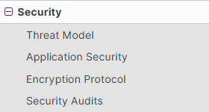
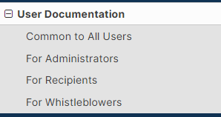
1) Security in Global Leaks Authentication, password security, web application security (sessions, cookies, XRSF prevention), data encryption, database security, secure file management, etc... \
2) User Documentation
https://docs.globaleaks.org/en/main/user/index.html

Slide 22
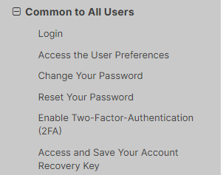
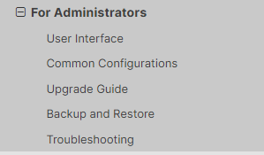
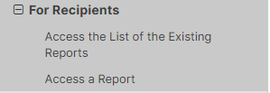

https://docs.globaleaks.org/en/main/user/Whistleblower.html

Slide 23
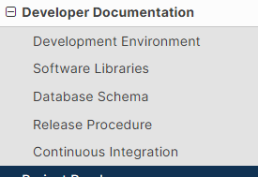
3) Developer Documentation
Developer Documentation — GlobaLeaks 4.14.8 documentation

Slide 24
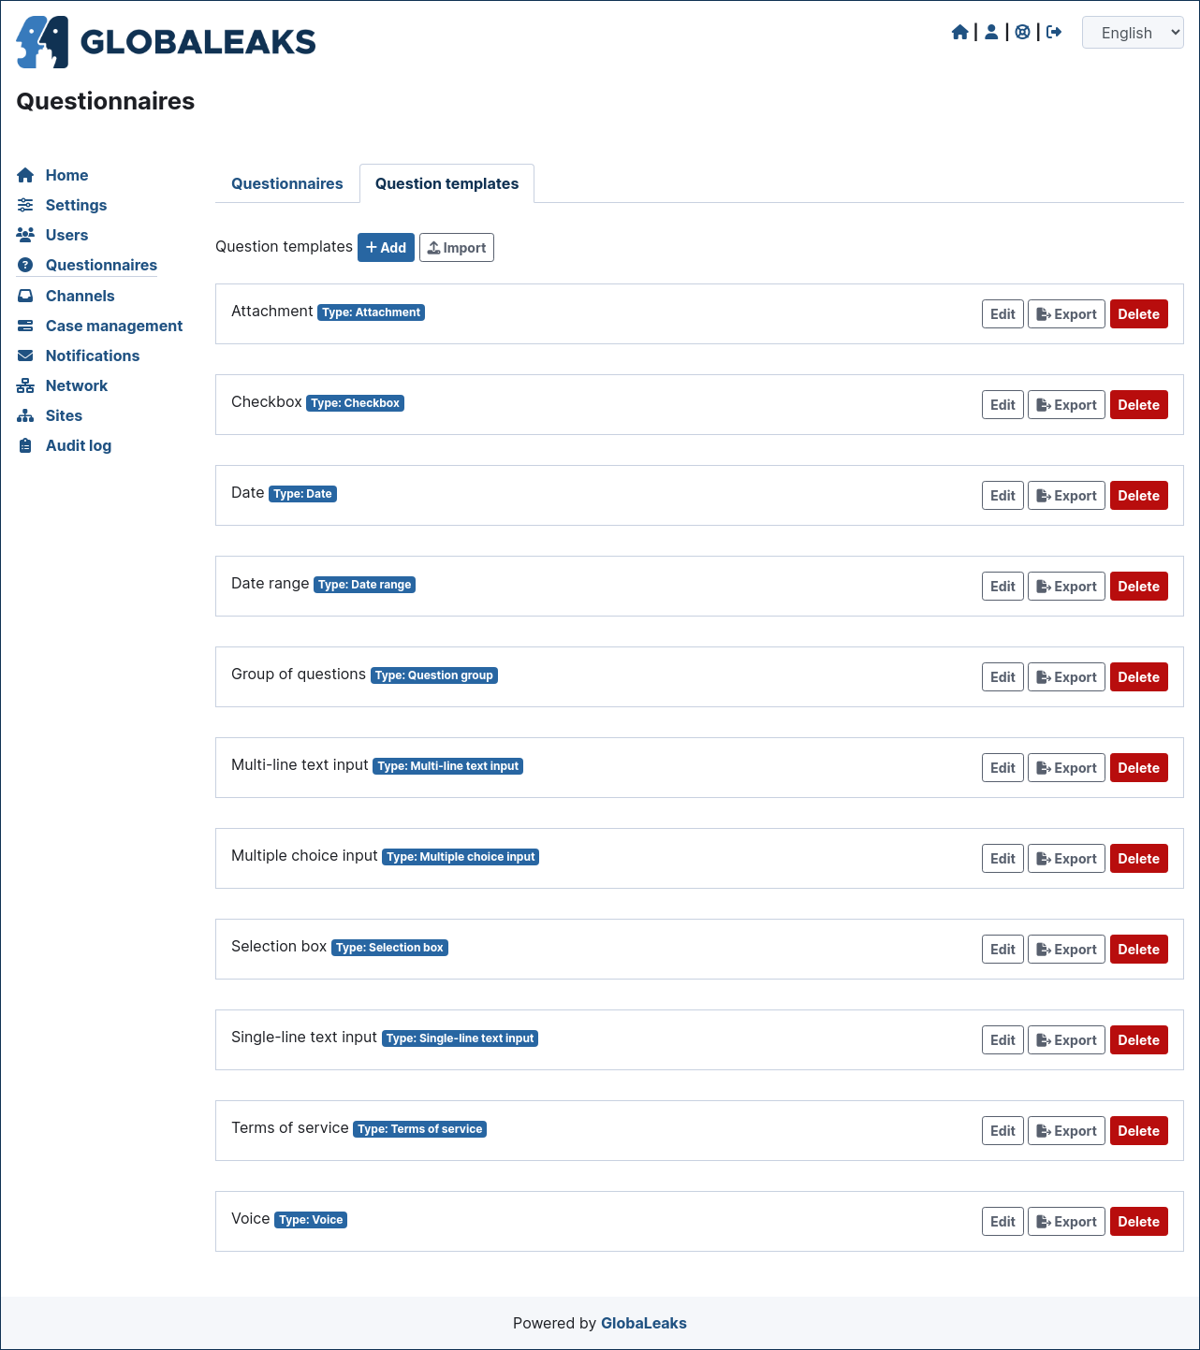

Slide 25
Leaflet (Geo Mapping)
What is Leaflet ? Leaflet is an open-source JavaScript library for creating interactive maps on web pages. It provides a lightweight and customizable solution for displaying geographical information and integrating various mapping features into web applications.
Why use Leaflet? Leaflet is lightweight, highly customizable, and has a large community support, making it ideal for simple to moderately complex mapping needs.
Features : Leaflet offers features like tile layers, markers, popups, and interactions, along with extensive plugin support for additional functionality. (Interactive Choropleth Map)
Documentation : Leaflet's documentation is straightforward and comprehensive, offering clear explanations and examples for developers, making it easy to get started and integrate into projects. (Documentation)

Slide 26
Useful APIs

Slide 27

WhatsApp Whistleblowing
Webhook Configuration: Set up your WhatsApp Business API client and provide a webhook URL. This URL is an endpoint on your server.
Message Reception: When a message is sent to your WhatsApp Business account, the API receives it.
HTTP POST Requests: The API forwards the message as an HTTP POST request to your webhook URL. This includes the message content, sender information, timestamp, and other metadata in JSON format.
Server Processing: Your server, listening at the webhook URL, receives this POST request. Run a backend application on your server (using technologies like Node.js with Express.js, or Python with Flask/Django) to handle this request.
Data Extraction and Handling: The backend application processes the request, extracting and using the data from the JSON payload as needed (e.g., storing in a database, responding to messages).
Response: Optionally, your server can send a response back to the WhatsApp API, typically acknowledging receipt of the message.
Notes:
The WhatsApp Business API works by sending incoming messages to a webhook URL that you specify and configure. Here's how it typically works:
Webhook Configuration: When you set up your WhatsApp Business API client, you are required to provide a webhook URL. This URL is an endpoint on your server where the WhatsApp API will send HTTP POST requests containing the message data.
Message Reception: When someone sends a message to your WhatsApp Business account, the API receives this message. Instead of storing it or processing it on its own, the API forwards this message to the webhook URL you provided.
HTTP POST Requests: The data is sent as an HTTP POST request to your webhook URL. This data usually includes the message content, sender information, timestamp, and other relevant metadata. The format is typically JSON.
Server Processing: Your server, which is listening on the webhook URL, receives this POST request. You need to have a backend application (like a Node.js app with Express.js, a Python app with Flask or Django, etc.) running on your server that can parse and process this request.
Data Extraction and Handling: Your backend application will then extract the necessary information from the JSON payload and can process it as needed - for example, by responding to the message, storing information in a database, triggering other actions, etc.
Response: While the primary purpose of the webhook is to receive data, your server can also send a response back to the WhatsApp API. This is typically a simple acknowledgment that the message was received.
Security and Authentication: To ensure security, the communication is typically over HTTPS, and you may need to implement validation to confirm that the incoming requests are genuinely from WhatsApp.
In summary, the WhatsApp Business API automatically forwards incoming messages to the webhook URL you configure, and it's up to your server application to handle these messages according to your business logic and requirements.

Slide 28

SMS Whistleblowing
Choose SMS Gateway: Select an SMS gateway provider (like Twilio, Nexmo, Plivo).
API Integration: Integrate your server with the SMS gateway's API.
Set Up Webhook: Configure a webhook URL in the SMS gateway to receive messages.
Receive Messages: SMS messages sent to your gateway number are received by the service.
Handle HTTP POST Requests: The gateway forwards SMS data to your server via HTTP POST requests to the webhook URL.
Server Processing: Your server processes these requests using a backend application (Node.js, Python, etc.).
Extract and Process Data: The backend application processes the SMS data (stores in database, triggers actions).
Send SMS Responses: Use the gateway's API for sending SMS replies or messages.
Implement Security: Secure the communication with HTTPS and validate incoming requests.
Manage Costs and Limits: Be mindful of the SMS gateway's costs and message limitations.
Notes:
Certainly, the process for handling SMS messages and integrating them with a server is somewhat different from the WhatsApp Business API process, due to the different nature of SMS technology. Here's a brief summary of the steps for an SMS integration:
SMS Gateway Service: Choose an SMS gateway provider. This service will act as an intermediary to send and receive SMS messages. Popular services include Twilio, Nexmo, Plivo, etc.
API Integration: Integrate the SMS gateway's API with your server. This typically involves setting up an account with the SMS gateway and using their API to send and receive messages.
Webhook Configuration: Configure a webhook URL in the SMS gateway service. This URL is an endpoint on your server where the SMS gateway will send HTTP POST requests containing the SMS data.
Message Reception: When an SMS is sent to the phone number provided by your SMS gateway service, the service receives the message.
HTTP POST Requests: The SMS gateway forwards the message as an HTTP POST request to your webhook URL. This usually includes the message content, sender's phone number, timestamp, and other relevant metadata. The format is typically JSON.
Server Processing: Your server, listening at the webhook URL, receives this POST request. You should have a backend application running on your server (using technologies like Node.js with Express.js, Python with Flask/Django, etc.) to process this request.
Data Extraction and Handling: The backend application extracts necessary information from the JSON payload and processes it as needed, such as storing it in a database, triggering automated responses, etc.
Sending SMS Responses: If you need to send a reply or any other SMS, use the SMS gateway's API to send messages back to the users.
Security and Authentication: Ensure secure communication by using HTTPS for your webhook endpoint and implementing validation to confirm the legitimacy of incoming requests.
Billing and Limitations: Be aware of the costs associated with sending and receiving SMS messages through the gateway, as well as any limitations on message volume or frequency.
This process allows you to integrate SMS messaging into your applications, enabling communication with users who prefer or require SMS over internet-based messaging services.

Slide 29

Option 2
Build whistleblowing backend from scratch.
Use WhatsApp and SMS APIs to allow multi-way reporting
Use Libraries and APIs for frontend

